Slide 1

Mid-Year Board Goals Update
February 2, 2024

Slide 2
ICCB Board Goals
GOAL 1: To support all students with a focus on minority, first-generation, and low-income students across urban, rural, and suburban communities, through the promotion of evidence-based best practices that close equity gaps resulting in system-wide improvement of equity metrics across enrollment, retention, advancement, and completion.
GOAL 2: To support a seamless transition for students into and through postsecondary education and the workforce by fostering the development of robust career pathways aligned to the needs of business and industry, strong engagement at all levels of the community college system, and with a focus on meeting students where they begin their educational journey, resulting in equitable access and outcomes for all students.
GOAL 3: To contribute to economic and workforce development by supporting the Illinois community college system’s effort to provide high-quality, dynamic workforce training opportunities that build essential skills for high-value work through apprenticeships, work-based learning opportunities, and competency-based instructional models that result in equitable economic mobility through increased credential attainment. The Board will implement its goals with a focus and commitment to equitable access, opportunities, and outcomes for all students. The Board will promote best practices, enable evidence-based decision-making, and support system-wide continuous improvement.

Slide 3

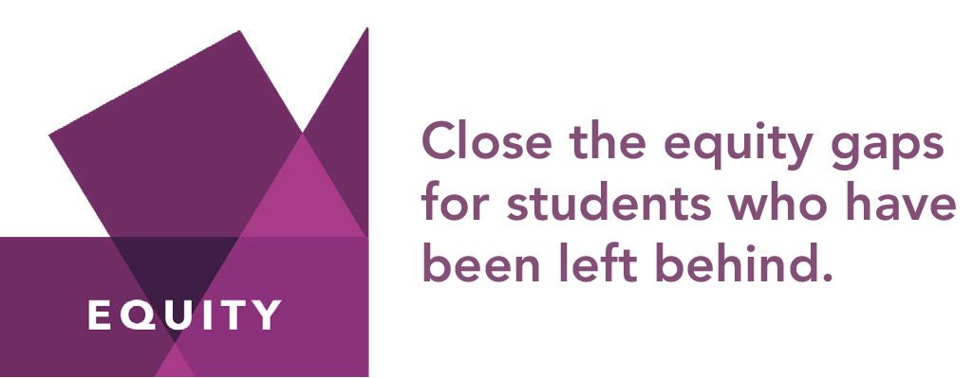


Strategies for a Thriving Illinois
Notes:
The strategies outlined in this plan are designed to close equity gaps, build stronger financial futures, and increase talent and innovation to drive economic growth.
We outlined 25 strategies in the full plan. We’re going to highlight just a few in the presentation today, but as you will see all are grounded in equity.

Slide 4
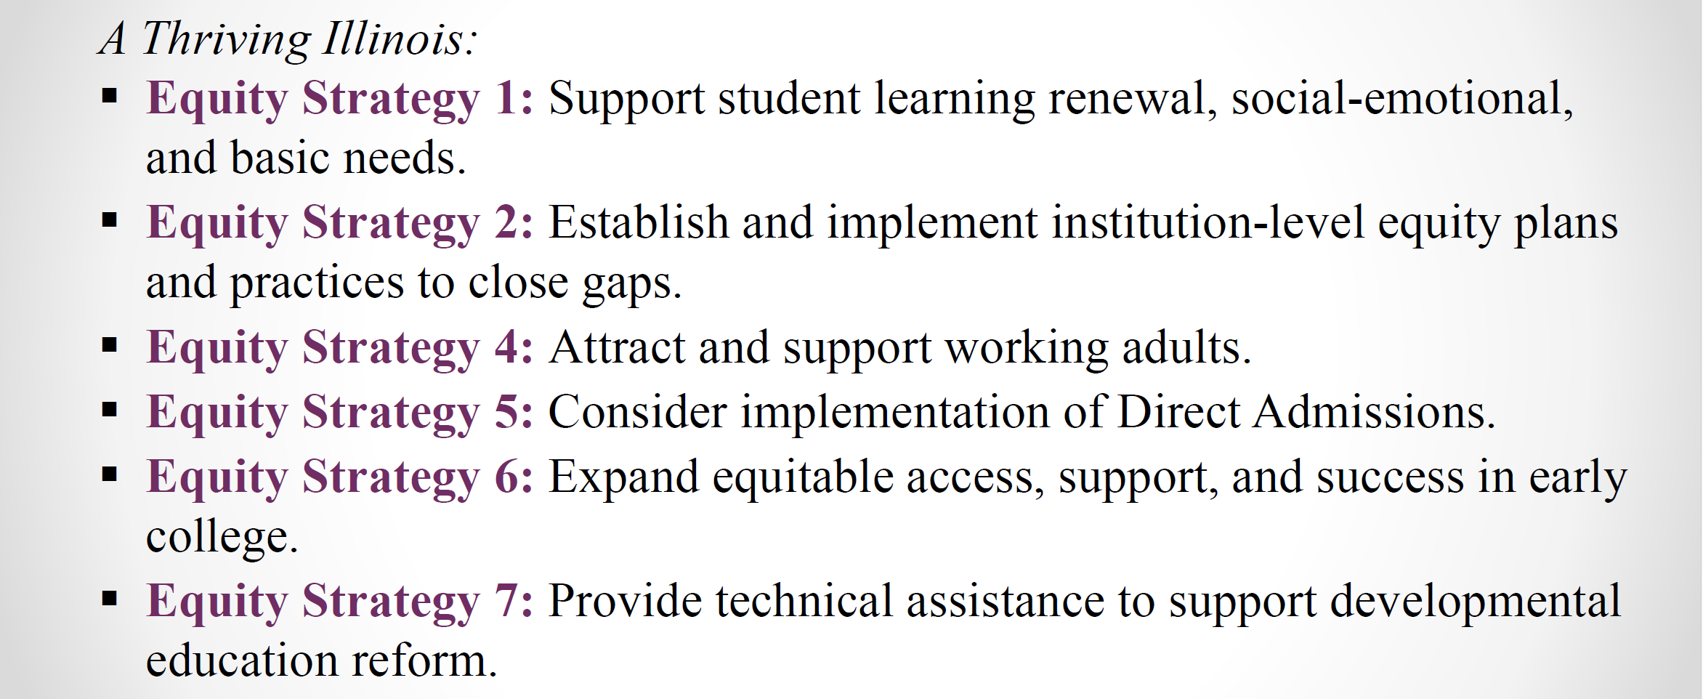
ICCB GOAL 1: Equity with Metrics

Slide 5
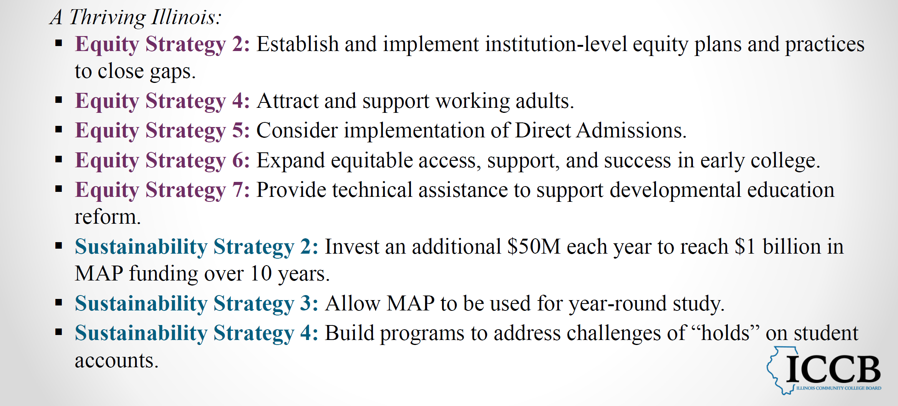
ICCB GOAL 2: Seamless Transition to Postsecondary and Work

Slide 6
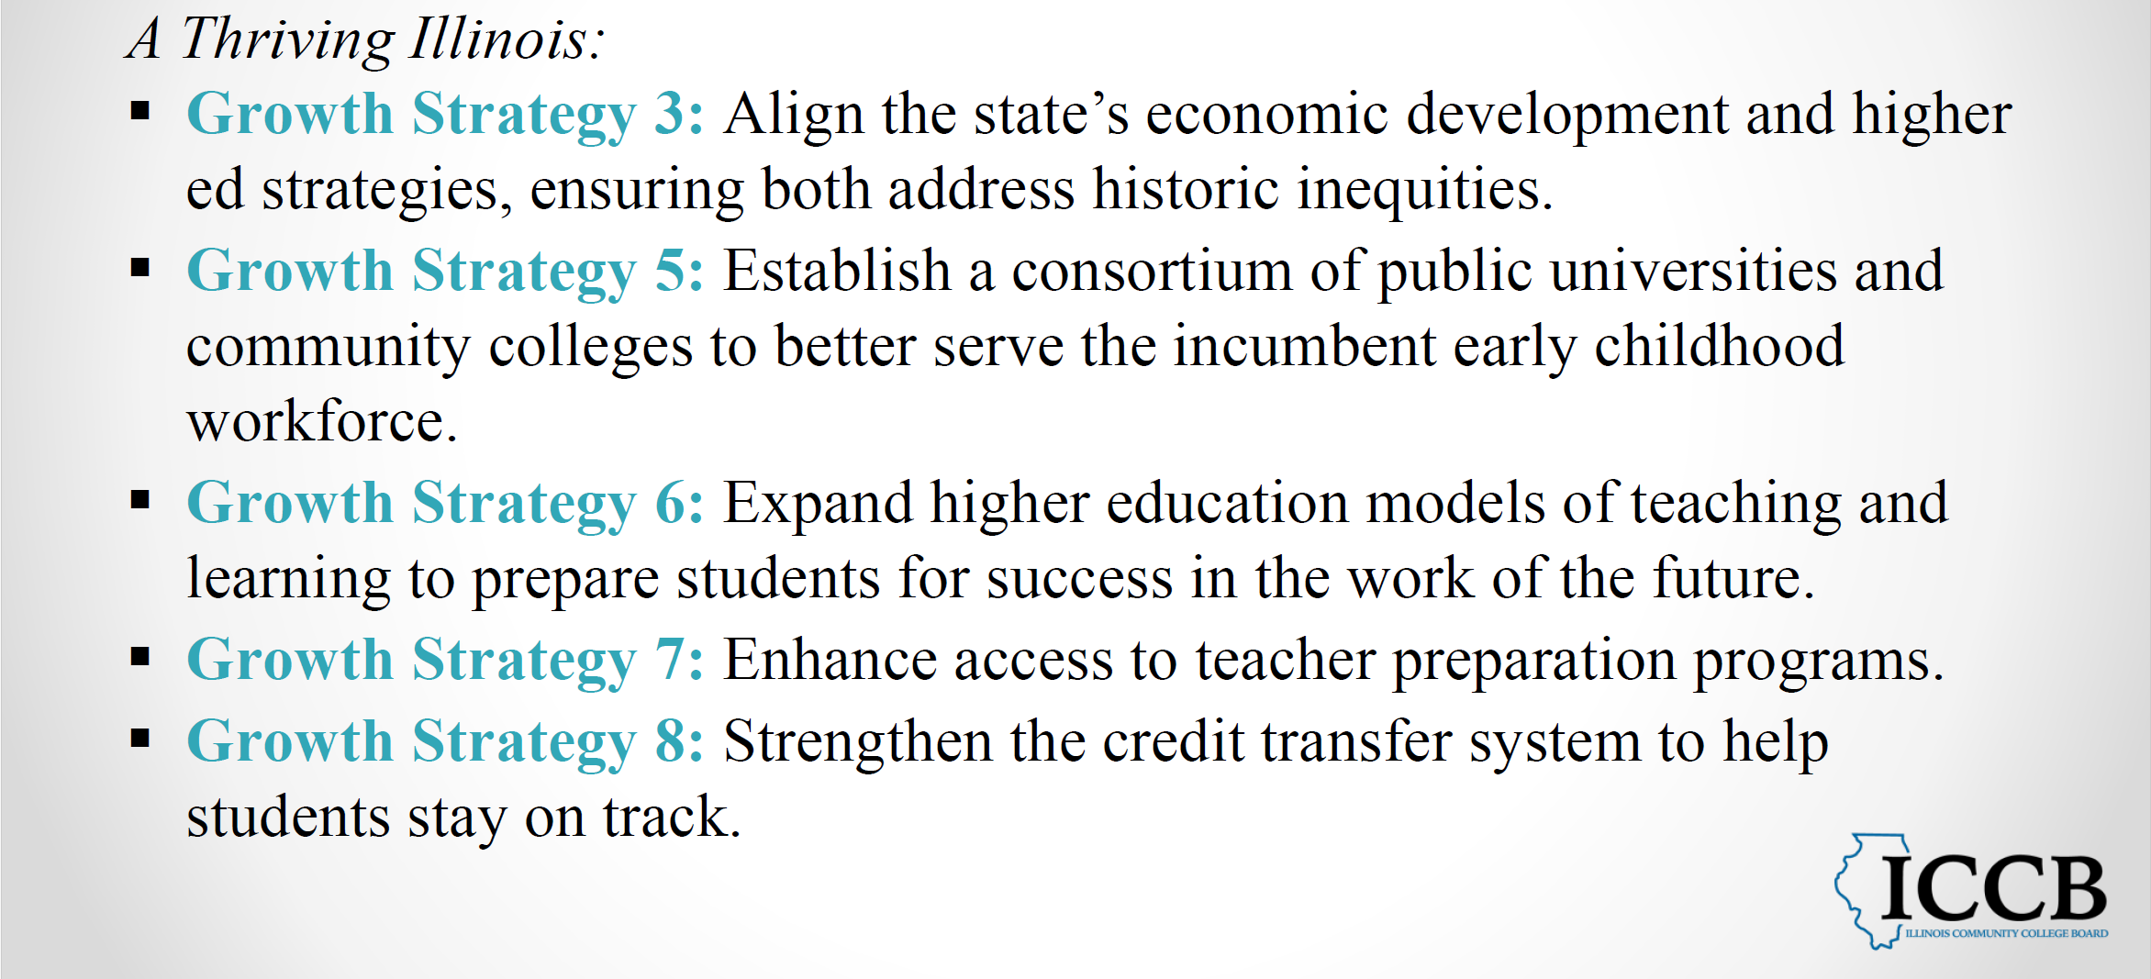
ICCB GOAL 3: Economic and Workforce Development

Slide 7


Illinois Board of Higher Education
Presentation to the ICCB
February 2, 2024
Notes:
The Illinois Board of Higher Education is the state agency responsible to coordinate, or as the 1964 founding document described it—”as otherwise bringing harmony” to the “disparate boards and institutions of the state’s system of higher education”. One of our central responsibilities is to develop in collaboration with the Illinois Community College Board a strategic plan and set a strategic direction for higher education in the state. In June, 2021 IBHE adopted the new strategic plan, called “A Thriving Illinois.” Soon thereafter, ICCB and ISAC endorsed the plan.

Slide 8
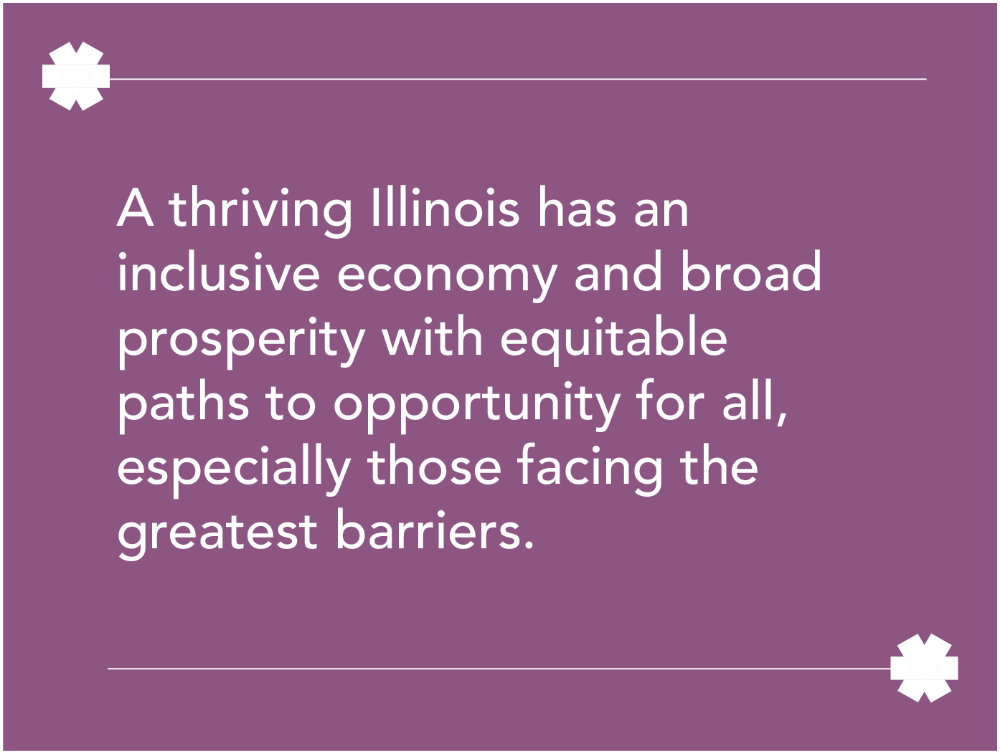
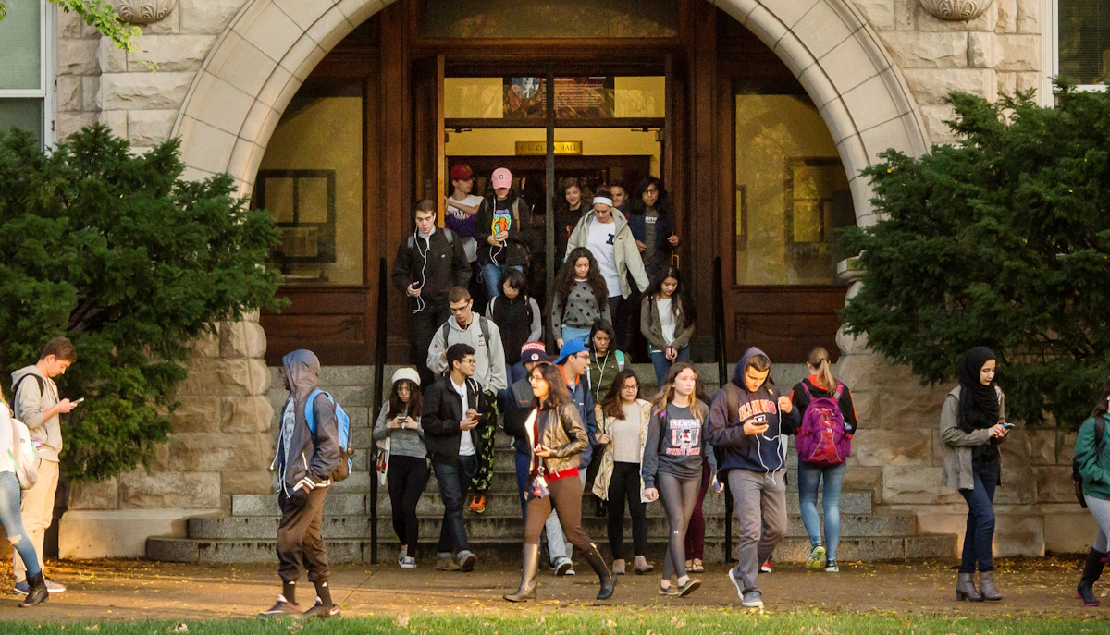
A Thriving Illinois
Notes:
If I were to capture A Thriving Illinois in a couple of slides, we would have to start with this one—with the definition of “thriving” and its focus on an inclusive economy, broad prosperity and equitable paths to opportunity.
We also recognize that higher education is the path to a thriving Illinois and the recognition that educational equity and Illinois’ economic growth are inseparable.

Slide 9
Strategies for a Thriving Illinois
Notes:
The strategies outlined in this plan are designed to close equity gaps, build stronger financial futures, and increase talent and innovation to drive economic growth.
We outlined 25 strategies in the full plan. We’re going to highlight just a few in the presentation today, but as you will see all are grounded in equity.

Slide 10
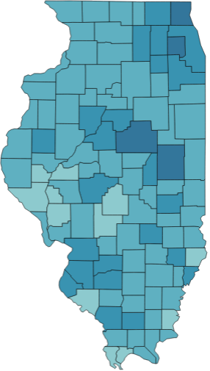
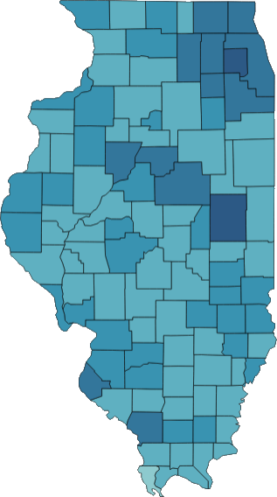
Postsecondary attainment has increased but geographic disparities persist
2013 Associate
or Higher
2022 Associate or Higher
State Average: 39%
State Count: 3,308,365
Total State Population 25+: 8.509,739
State Average:
45%
State Count:
3,935,431
Total State
Population 25+: 8,746,416
Source: 2022 American Community Survey 5-Year Estimates
See all interactive Equity Maps
Notes:
Let’s start with attainment-the percentage of adults with a post-secondary degree or credential.
Here –maps of adults over age 25 with an associate degree or higher.
In the 2013, as you see on the map on the left, 39% of adults had an associate or higher, and by 2021, 44% did.
But you can see wide variation across the state, with the darker areas representing larger percentages with degrees.
Map on the right—range from 21% (Brown) to the top county at 58% (DuPage)
The good news is that every county experienced positive growth in attainment between 2013 and 2021
But we don’t have equitable paths to opportunity across the state without access to higher education
Would also note that maps come from interactive tools on IBHE’s website—can look at all the data for each year from 2010 forward; at multiple educational levels; for each county; with comparisons.

Slide 11
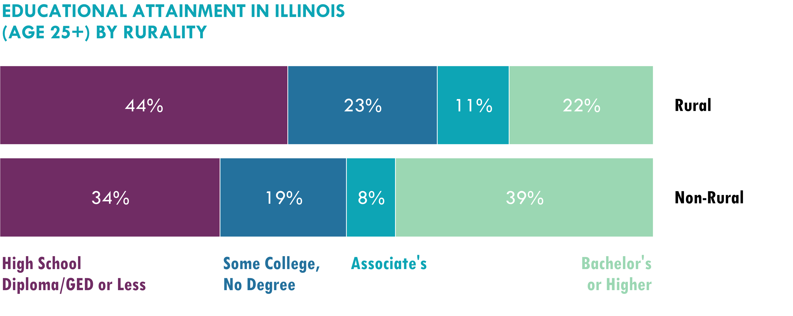
Rural adults less likely to have bachelor’s degree
Source: 2022 American Community Survey 5-Year Estimates
Notes:
Cutting geography another way, we have comparisons for adults in rural compared to non-rural communities. We see that rural adults are less likely to have a Bachelor’s degree but more likely to have an associate or some college than adults from non-rural areas. We also see that more rural adults have a high school diploma, GED, or less education than non-rural adults.

Slide 12
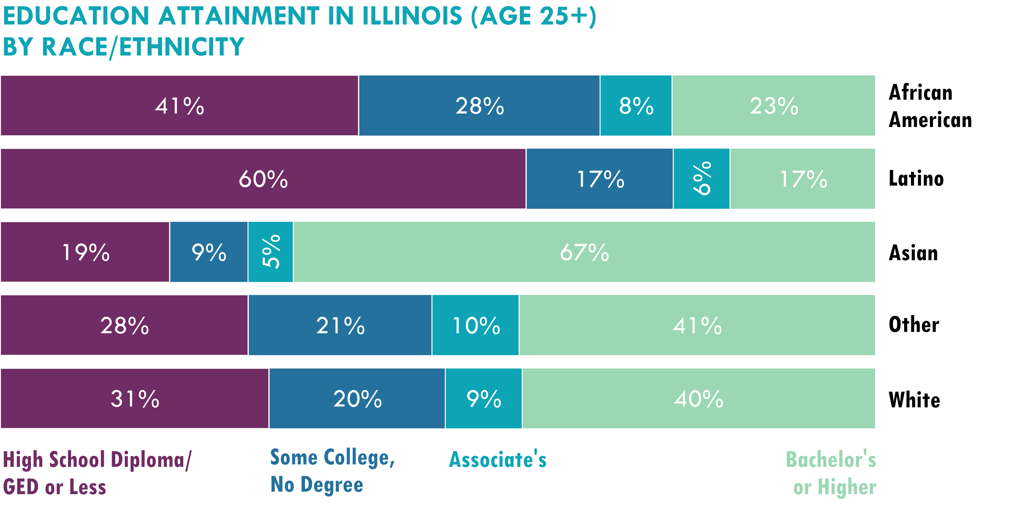
Disparities in Postsecondary Attainment
Source: 2022 American Community Survey 5-Year Estimates
Notes:
The disparities in attainment outcomes are stark when we disaggregate by race/ethnicity. While 48% of white adults have a degree, only 31% of African American and 22% of Latino do.
Equally significant are the percent of adults who started college but never received a degree: 21% of white, 28% of African American and 17% of Latino adults. That represents 323,389 African Americans, 207,682 Latinos, and 1,159,865 white adults.
Another 42% of African Americans, 64% of Latinx, and 32% of white adults have a high school diploma, equivalent or less education.
This shows us the tremendous opportunity we have by better serving adults in our higher ed system closing historical equity gaps.
Let’s look more closely at the equity gaps.

Slide 13
Equity Gaps Facing African American Students
ENROLLMENT CHANGE OVER TIME
2021 GRADUATION RATES
Enrollment has decreased by 37%
for African Americans.
37.3%
70.2%
15.4%
40.2%
2013
107k students
enrolled
Public Universities
Community Colleges
2021
67k students
enrolled
43.6%
69.8%
19.4%
43.8%
African American
White
Non-Profit Institutions
For Profit Institutions
Notes:
First, a look at the experience of African American students.
Between 2013 and 2019, enrollment dropped 34% for African Americans at the same time that enrollment for white undergraduates dropped by 26%. And this is even before the disparate impact of COVID. Now we have the impact of COVID and enrollment dropped even more. There are now 40,000 few African American students enrolled than there were in 2013. That is a 37% drop in African American undergraduate students compared to 34% decline in white students.
We know from other IBHE analysis that African American students have less access to early college experiences and are more likely placed in developmental education, less likely to be retained and advanced in class status.
All this leads to dramatic and persistent gaps in the rates institutions graduate students, which you can see on the charts on the right.

Slide 14
Equity Gaps Facing Latinx Students
ENROLLMENT CHANGE OVER TIME
2021 GRADUATION RATES
Enrollment has increased by 3%
for Latino students.
53.1%
70.2%
27.0%
40.2%
2013
118k students
enrolled
2021
122k students
enrolled
Public Universities
Community Colleges
58.7%
69.8%
40.8%
43.8%
Latino
White
Non-Profit Institutions
For Profit Institutions
Notes:
Next, as we look at the experiences of Latinx students, we see enrollment has increased by 3% since 2013, with just over 122,000 student enrolled. But you can see the pandemic impact here—in 2019, just over 128,000 Latinx students were enrolled.
However, our analysis shows that gaps exist in the rates institutions retain and advance Latinx students compared to white students, which means that we see that institutional gaps in completion rates exist, and persist over time. The good news is that completion rates at public universities increased from 52.3% in 2019 to 53.1% in 2021.

Slide 15
Equity Gaps Facing Low-Income Students
ENROLLMENT CHANGE OVER TIME
2021 GRADUATION RATES
Enrollment has decreased by 36%
for low-income students
50.4%
73.2%
28.4%
36.6%
2013
280k students
enrolled
Public Universities
Community Colleges
2021
180k students
enrolled
54.3%
74.5%
29.0%
56.8%
Pell
Non-Pell
Non-Profit Institutions
For Profit Institutions
Notes:
The same patterns of inequity exist for low-income students. Between 2013 and 2021, Illinois enrolled over 100,000 fewer low-income undergraduate students, a 36% decrease, compared to a 22% decrease for non-low-income students. We are really seeing the pandemic impact here. For comparison, between 2013 and 2019, we saw a drop of 85,000 low-income students.
Our data analysis shows gaps in access to early college, retention, and advancement for low-income students compared to non-low-income students.
And, again, we see institution completion rate gaps.
To sustain a thriving state, we must create a more equitable reality.

Slide 16
College enrollment gaps by race/ethnicity persist for high school graduates
Source: Illinois State Board of Education
16
Notes:
And as we disaggregate that by race, we can see there are much lower college going rates for African American and Latino high school graduates
Eliminating the initial college enrollment gaps (bringing African American and Latinos up to 65.5%)
would equate to an additional 4,000 African American high school seniors and
5,400 Latino high school seniors who enroll in college the fall semester following HS graduation.
Eliminating the high school graduation gaps and the college going rates, would add another 325 Latino and 480 African Americans initially enrolling in college.

Slide 17
College-going gaps persist for low-income high school graduates
Total: 68.8%
Total: 44.4%
Source: Illinois State Board of Education
17
Notes:
Similarly the there is a large gap in college-going rates between low- income high school graduates and their counterparts
hasn’t narrowed and neither group has recovered to pre-pandemic college-going rates.

Slide 18
Retention and advancement gaps persist for African American students
Retention and Advancement of New First-Time
Full-Time Students at all Illinois Public Universities
Retention and Advancement of New IL CC Transfer
Full-Time Students at Illinois Public Universities
Source: IBHE IHEIS Fall 2018-19 to Fall 2021-22 Enrollment Collections – New Transfer Full-Time Students from Fall of AY2018-19, Fall of AY2019-20, Fall of AY2020-21 tracked to the next Fall.
18
Notes:
And beyond enrollment is persistence:
Here we focus on retention—a student remains at the same school from their first year to the next—the solid lines
And advancement—earning enough credits to move on to the next class level—the dashed lines
We see those two measures for white students in green and African American students in blue.
On the left are the comparisons for first-time, full-time freshmen at public universities, and you see huge 20 pp gap in retention rates and 40% gap in advancement
On the right are the same trends for community college transfer students. Not only are the gaps much smaller, but the rates are much higher overall.
There are certainly gaps that need to be closed and an opportunity to build on the already higher rates for community college transfers

Slide 19
Retention and advancement gaps persist for Latino students
Retention and Advancement of New Full-Time Freshmen Illinois Public Universities
Retention and Advancement of New IL CC Full-Time Transfer Students at Illinois Public Universities
Source: IBHE IHEIS Fall 2018-19 to Fall 2022-23 Enrollment Collections – First-Time Full-Time Students from Fall of AY2018-19,
Fall of AY2019-20, Fall of AY2020-21 tracked to the next Fall.
19
Notes:
Here is the same data for Latino students.
There are gaps to close and opportunities to increase the advancement rate, with the rates much higher and no gaps for transfer students

Slide 20
Retention and advancement gaps also persist for low-income students
Retention and Advancement of New First-Time Full-Time Students By Pell Status at All Illinois Public Universities
Retention and Advancement of New IL CC Transfer Full-Time Students By Pell Status at All Illinois Public Universities
For discussion purposes only
20
Source: IBHE IHEIS Fall 2018-19 to Fall 2022-23 Enrollment Collections – New FT transfer Students from Fall of AY2018-19,
Fall of AY2019-20, Fall of AY2020-21, Fall of AY2021-22 tracked to the next Fall.
Notes:
And a similar look for low-income students—with much higher retention and advancement rates and almost no gaps for transfer students, but more can be done for first-time freshmen.

Slide 21
Over 1.7 million adults have some college but no degree
Source: 2020 American Community Survey 5-Year Estimates
21
Notes:
Finally, as we opened with a look at adults with an associate degree or above, now we look at those who have some college but never received a degree.
There is tremendous opportunity to serve these adults--including 323,000 African American adults, 200,000 Latino, 1.2 million white and 68,000 Asian.

Slide 22



Equity Strategy 1: Support student learning renewal, social-emotional, and basic needs
Grants, Collaboration, and Communities of Practice
Benefits Navigators
HOUSE Liaisons
Illinois Campus Cares Mental Health Services and
Illinois Campus Cares Technical Assistance Center
Notes:
Strategic Plan developed during the pandemic—significant concern about impact on learning, mental health, basic needs that were always there but exacerbated by the pandemic and disproportionately impacted students of color, low income students, working adults, those already facing the greatest barriers. Use federal GEER funds to invest in supports; EXAMPLES OF WORK FUNDED; working on a report summarizing impact. But needs transcend the pandemic--
Over the past several years, the General Assembly has required institutions to establish specialized positions to meet student support needs. IBHE is convening communities of practice to support the work of Benefits Navigators, HOUSE liaisons, undocumented student liaisons, and others. Funds have also been included in the budget to support mental health on campus, with IBHE establishing a technical assistance center.

Slide 23

Equity Strategy 2: Establish and implement institution-level equity plans and practices to close gaps
Enacted in P.A. 102-1046, June 7, 2022.
Required of all public institutions of higher education. Encouraged for private institutions.
Equity Plans and Practices to close gaps in enrollment, retention, completion, and student loan repayment rates.
Focus on Black, Latinx, AAPI, Native American, rural, adult, women, & people with disabilities.
IBHE, with ICCB, to establish guidelines, provide support, study, report effectiveness and outcomes .
annually to the General Assembly/Governor.
Framework released to institutions Nov. 9, 2023
First baseline plan due May 31, 2024
23
Notes:
A Thriving Illinois called on institutions to develop and implement equity plans and practices to close gaps; this was subsequently included in statute.
The plans will outline specific steps to close equity gaps including:
--learning renewal strategies in Strategy 1
--Review and revise existing policies and practices that exacerbate equity gaps
--Implement practices of interrogating disaggregated data at multiple levels to understand points of intervention and whether solutions are working; predictive analytics
--Equity impact analysis—structured approach to ensuring decisions are made after analysis of impact on underserved groups
--Campus climate survey with actions based on findings
--Professional development designed to achieve equity
You will hear more about this in the next panel.

Slide 24

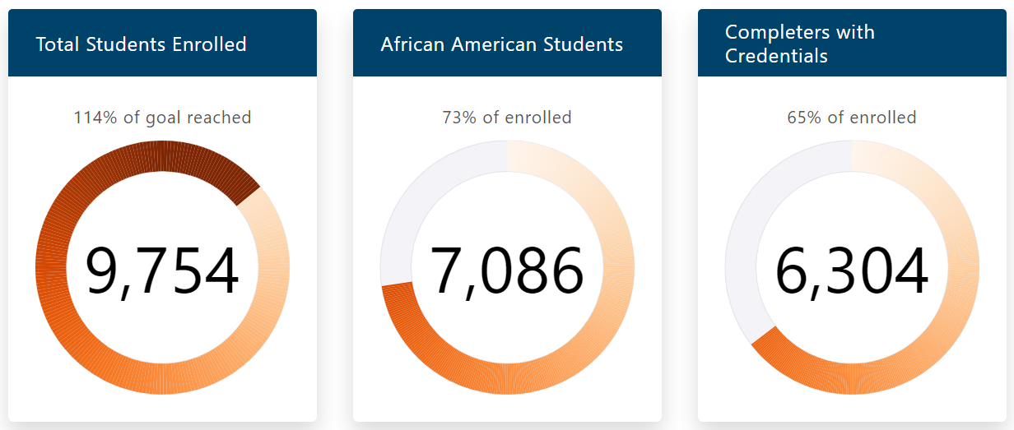
Equity Strategy 4: Attract and support working adults
Short-term workforce training at community colleges in high-need communities for specific sectors with workforce gaps.
Jobs/career pathways that lead to 30% above the average living wage.
https://www.illinoiswei.org/
60% must be African American
Over 120 programs at 18 community colleges enrolling 73% African American students.
24
Notes:
17 community colleges have provided short-term workforce training that leads to jobs that pay 30% above the average living wage. To date, 9,400 students have enrolled, 73% African American (exceeding the 60% goal). Nearly 8,000 credentials have been awarded.

Slide 25
Equity Strategy 5: Consider implementation of Direct Admissions
Public University Uniform Admission Pilot Program (110 ILCS 118/1)
NIU, SIU, EIU, AND WIU provide automatic general admission for students in top 10% of class
  Students must complete minimum college preparatory coursework
  Students must apply using regular admissions process
Expanded in 2023 to include community college transfer students beginning in AY 2024-2025
  Pilot began in AY 2022-2023 at U of I.
Transfer students guaranteed admission at these universities if:
  Enrolled in an Illinois community college after graduating from state high school;
  Earned a minimum of 36 graded, transferable hours;
  Attained 3.0 GPA on all transferable coursework; and
  Satisfied the universities English language proficiency requirement.
  Universities may implement less restrictive criteria than outlined in the law.
25

Slide 26

Equity Strategy 6: Expand equitable access, support, and success in early college
Impact of Dual Credit
Nearly doubles the graduation rate at community colleges, compared to high school students who did not take dual credit. Demographic data suggest similar results.
All 48 community colleges offer dual credit with over 13,000 dual credit courses to 75,000 students in academic year 2021.
Represents one in six students enrolled in community college courses annually.
$3.0M grant program for Community Colleges focused on:
Planning and implementation of strategies with the explicit purpose of supporting student persistence to college completion.
Supporting or improving equitable access to dual credit, focused particularly on students who have been historically underrepresented.
Proposals Received: January 26, 2024
26
Notes:
Equity #6
Dual credit:
The grant objectives are as follows:
Planning and implementation strategies with the explicit purpose of supporting student persistence to college completion, whether that be a two-year transfer degree, four-year baccalaureate degree, or CTE credential or degree. This strategy should be accomplished through an increase in transferrable core academic (e.g., General Education Core Curriculum coursework, such as math, English, or Communications) and/or CTE coursework on a career pathway, that students have available at their high school, or that are made available or enhanced as part of this project. This requires strong partnerships with high schools and building clear pathways from dual credit into the college after high school graduation, supporting wrap-around services and strengthening relationships across the district.
Supporting or improving equitable access to dual credit, focused particularly on students who have been historically underrepresented, including students from racial/ethnic backgrounds that are underserved, low-income students, and students in rural settings.

Slide 27
Equity Strategy 7: Provide technical assistance to support developmental education reform
Updating the Multiple Measures Placement Policy.
Updated ICCB Administrative Rules to meet Developmental Education
Reform Act (DERA) Requirements.
Evidence-Based Models.
  Co-Requisite Remediation Implementation Toolkit
February 2023 comprehensive report on development education reform efforts
More students placed in corequisite models: majority of math placements and overwhelming majority of English Language Arts placements
27

Slide 28
28

Slide 29
Sustainability Strategy 2: Invest an additional $50M each year to reach $1 billion in MAP funding over 10 years
Sustainability Strategy 3: Allow MAP to be used for year-round study
In FY02, the maximum MAP Award covered 100% of Public University tuition and fees. The unprecedented $222 million increase in FY23 and FY 24 increased coverage to 50% at public universities and 61% at community colleges
Not Covered
by MAP
Covered by MAP
44%
100%
39%
29
Notes:
There is no debate about the importance of MAP in supporting low-income students and its role in our higher education ecosystem. It is our second Strategy to achieve the Sustainability goal.
A Thriving Illinois calls for a $50M annual increase in MAP funding to reach $1B in funding within 10 years (ie 2031)
The Governor has made historic investments in MAP, with MAP now at a record $701 Million, with increases of $100M or more over the past two years. This is well ahead of the timeline we anticipated in developing A Thriving Illinois and it means that in the past year, every eligible student was offered an award and the amount of the award increased to cover even more tuition and fees.

Slide 30
Sustainability Strategy 4: Build programs to address challenges of “holds” on student accounts
Student Debt Assistance Act (110 ILCS 66/1 ) prohibits withholding transcript even if student owes a debt
Covers all public universities and community colleges, Private Business and Vocational Schools, and any postsecondary education offered online to someone in Illinois
        Institution to develop policies for financial or physical hardship withdrawal and how to obtain transcript that has been withheld because of debt
          Debt sent to collection agency cannot be reported to a credit reporting agency
          Notice and process for students to file a complaint with the Attorney General’s Office
          Starting July 1, 2024 institutions report annually IBHE or ICCB
Institutions implement innovative programs to help students with outstanding balances return to school
Chicago State University Cougar Return
City Colleges of Chicago Fresh Start
Notes:
No withholding of transcript for:
Complete a job application
Transfer from one institution to another
Apply for state, federal, or institutional financial aid
Join the US Armed Forces or Illinois Nati
National Guard
Pursue other postsecondary opportunities
Applies to all institutions of higher education, including public universities and community colleges, Private Business and Vocational Schools, and any postsecondary education offered online to someone in Illinois
Institutions must have policies for Financial or physical hardship withdrawal process to limit debt for students who must withdraw and how to obtain transcript that has been withheld because of debt
Debt sent to collection agency cannot be reported to a credit reporting agency
Notice must be posted and process for filing a complaint with the Attorney General’s Office provided on institution’s website and in information on the total cost of attendance
On July 1, 2024 and every year after, institutions report to IBHE or ICCB on financial transcript holds, registration holds, including the policy developed number of transcripts withheld for prior AY.
Debt relief pool—ECACE
Cougars Return: Debt forgiveness up to $1,500 for UG left without a degree within last 3 years and within a few semesters of graduation
CCC Fresh Start—enrolled at CCC and left with debt of at least $201 prior to July 1, 2022; half waived if stay enrolled in current semester and make SAP; other half waived when receive credential

Slide 31
31
Notes:
Now we turn our focus to talent development to support Illinois’ economy.

Slide 32


Growth Strategy 3: Align the state’s economic development and higher ed strategies, ensuring both address historic inequities
Non-credit workforce training grant for community colleges to:
Engage with employers
Develop curriculum and deliver non-credit customized training to prepare individuals with specific technical skills
Partner with employers to conduct skill assessment of employees.
Deliver essential employability skill development workshops for employees to ensure individuals are successful in the workplace.
Conduct professional development training for employees for staff development, retention, and improved workplace culture.
Provide other business solutions to increase efficiency and competitiveness.
Provide supports to students through coordination with workforce partners
New Non-Credit Workforce Training Grant
Customized training and business solutions
Community colleges have a long background in providing customized training and specialized business solution services to local employers.
Increases innovation and economic development, helping companies upskill their incumbent workforce.
32
Notes:
Growth #3
Engage with employers to determine needs and solicit interest.
Develop curriculum and deliver non-credit customized training to prepare individuals with specific technical skills to attain industry recognized credentials and employment in high demand/high wage areas.
Partner with employers to conduct skill assessment of new or current employees.
Deliver essential employability skill development workshops for new hires or current employees to ensure individuals are successful in the workplace.
Conduct professional development training for employees in order to support staff development, retention, and improve workplace culture.
Provide other business solutions to support business efforts to increase efficiency and competitiveness.
Provide supports to students through coordination with workforce partners

Slide 33
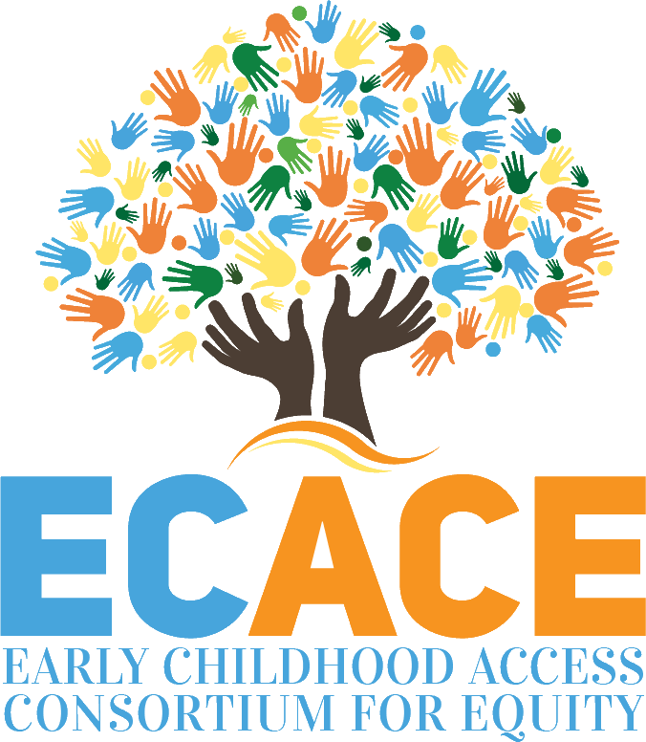

Growth Strategy 5: Establish a consortium of public universities and community colleges to better serve the incumbent early childhood workforce
        Streamline degree completion for workforce
        Students can take coursework at multiple consortium institutions
        Community colleges degrees transfer in their entirety
  Navigators provide personalized assistance for application and financial aid and connection to Coach
  Coaches and Mentors support students to persist and complete their studies
Scholarships for students and funding for institutions
Enrollment increased 22% from 4,825 to 5,887
Embodied in 110 ILCS 28/
www.ecace.org
Notes:
Next we wanted to highlight the work we are doing to upskill the early childhood workforce through the Early Childhood Access Consortium for Equity.

Slide 34
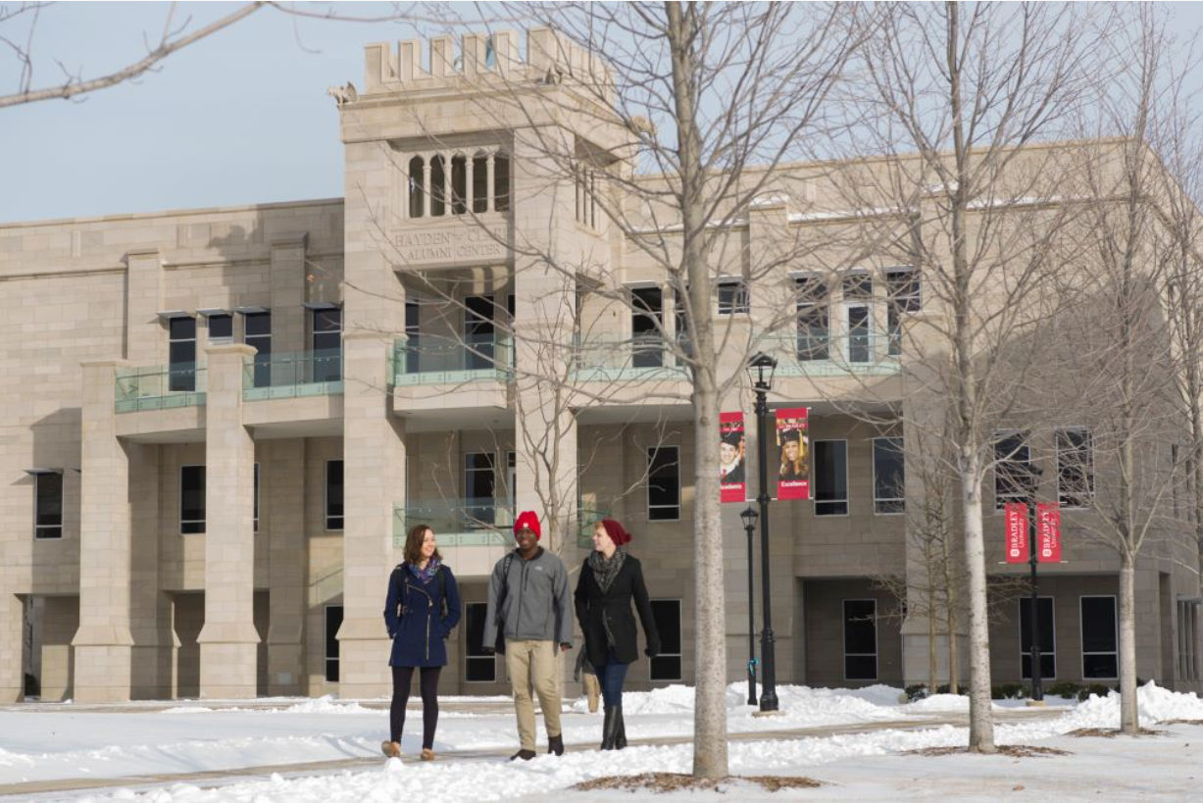

Strategy 6: Expand models of teaching and learning to align with work of the future;
Strategy 7: Enhance access to educator preparation programs;
Strategy 8: Strengthen statewide transfer system
ICCB Dedicated staff with a focus on teacher education
Exploring alternative teacher education models.
Convening Teacher Education Panels in the Illinois Articulation Initiative
Implementation of Senate Bill 2288 – Major Acceptance Legislation
Exploring technological innovations
Examining Direct Admissions Processes
Convening Transfer Working Group through the Higher Education Futures Table
ICCB Proposed legislation to waive transfer application fees
www.itransfer.org
Notes:
Next we wanted to highlight the work we are doing to upskill the early childhood workforce through the Early Childhood Access Consortium for Equity.

Slide 35
Next Steps outlined in A Thriving Illinois
Immediate next steps from A Thriving Illinois:
  Develop an Accountability System
  Launch Development of Institutional Equity Plans
  Convene a Business and Employer Advisory Council to IBHE
  Develop a Public University Funding System
  Reinforce Learning Renewal and Social Emotional Supports
  Re-Engage Adults
  Respond to Early Childhood Educator Shortage
  Enhance Transfer Infrastructure
  Develop Full Implementation Plan
  = Work with comprehensive approach has begun
35

Slide 36
Where do we go from here?
We have on-going implementation work for what has already launched
We identified Strategies where we need to expand efforts or dig deeper
We have Strategies not yet launched
At the conclusion of A Thriving Illinois report, we identified immediate next steps
Question for Board consideration: What do you see as the priorities for the next three years?
36

Slide 37

Appendix

Slide 38
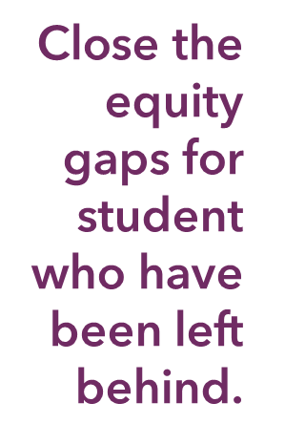
25 Strategies for a Thriving Illinois
Support learning renewal and student social emotional and basic needs
Implement institution-level equity plans and practices
Use equitable talent management to increase and retain faculty, staff and trustees of color
Provide more pathways through higher education for adults
Consider a direct admissions program to simplify college search and admissions
Expand equitable access to early college coursework for high school students
Support implementation of developmental education reform
Expand college access and support models to improve college-going and completion
38

Slide 39

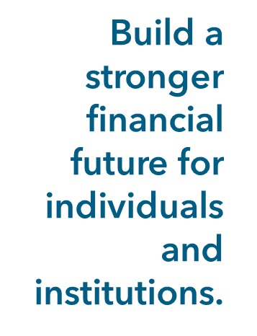
25 Strategies for a Thriving Illinois
Invest in public higher education through an equitable, stable, and sufficient funding system
Increase Monetary Award Program (MAP) funding to $1 billion over ten years
Allow MAP grants to be used for year-round study
Address the challenge of “holds” on student accounts that prevent them from completing their degrees
Support new low-interest loan programs through the Office of the Treasurer for low-income students
Encourage creative options for family savings through Illinois’ 529 plans
Pilot and expand shared services programs to reduce administrative costs
Expand joint purchasing among institutions
Invest
39

Slide 40
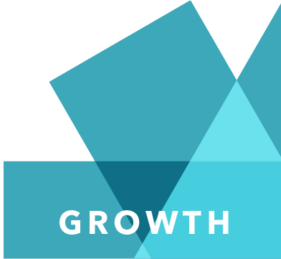
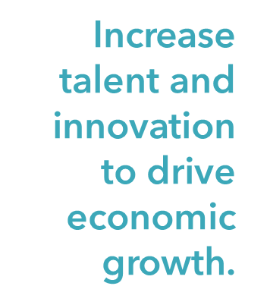
25 Strategies for a Thriving Illinois
Leverage the Illinois Innovation Network
Establish a statewide Business and Employer Advisory Council to foster the growth of Illinois’ talent pipeline
Align the state’s economic development and higher education strategies, ensuring that both address historic inequities
Encourage high school graduates to stay in-state for college and keep talent in Illinois
Establish a consortium of community colleges and universities to better serve the incumbent early childhood workforce
Expand higher education models of teaching and learning to prepare students for success in the work of the future
Enhance access to teacher preparation programs
Strengthen the credit transfer system to help students stay on track
Consider the role the Private Business and Vocational sector for workforce needs
40

